Slide 1
Progress Made: 22nd May – 4th June
Purpose of work done thus far
Data Pipeline for different formats
Recurrent neural network setups
Observed results
Insights from feature selection
Data preprocessing and script to divide up .mat files
Next things to be working on

Slide 2
Purpose of Work
Generally speaking, trying to find insights of .mat files through different measurements (joint angles, positions, accelerometer values, etc.) of NSAA and 6 min walk files by sequence modelling using RNNs and CRFs
Sequence modelling necessary to model the dependencies through time of measurements
E.g. likelihood of specific joint angle values at certain time period influenced by previous values
Likely to be a more robust model if measurement values are treated as NON independent with respect to time
(Current) aim is to build a reasonably good model that, when presented with new, unseen .mat files, can give a reasonably good approximation of individual NSAA scores and overall cumulative NSAA score
Main limitation currently is lack of data; limited by # of NSAA/6minwalk files
Could aid specialists in the scoring and assessment of patients’ activity scores
Another aim is to use a trained model to gain insights into most influential activities and measurements from .mat file on overall NSAA score and to identify activities that correlate highly with overall assessment
Possibly could enable the reduction of 17 activities to far fewer if only a few are needed to correctly assess the subject

Slide 3
Formats of Data: Raw joint angles from joint-angle or data cube
66 (3-dims for each 22 angle)
66 (3-dims for each 22 angle)
60 seq len (1s)
~22K
(360s at 60Hz)
Joint angles of a 6 min walk (e.g. ‘jointangleD4-6minwalk.mat’)
‘JA_D4.csv’ (identical data into .csv)
‘RNN.py’
~22K
(360s at 60Hz)
….
‘comp_stat_vals.py’
‘RNN.py’

Slide 4
Formats of Data: Statistical values of all-data files
‘comp_stat_vals.py’
‘ft_sel_red.py’
620 (~10 measurements x 51, 66, and/or 69)
~4K statistical values
~360 (1 row of stat vals for every 60 source rows)
All data of a 6 min walk OR NSAA file (e.g. ‘D11-012-NSAA.mat’)
‘AD_D11_stats_values.csv’ (360 x ~4K)
~22K
(360s at 60Hz)
30
30 (reduced via e.g. PCA)
10 seq len (10s)
‘FR_AD_D11_stats_values.csv’
~360
~360
….
‘RNN.py’

Slide 5
Recurrent Neural Network – Variations
Either raw joint angles written to .csv OR feature reduced stat values from all-data files
……
……
RNN.py
RNN.py
RNN.py
……
Overall NSAA regression score (between 0 and 34)
Classification of being from either ‘D’ or ‘HC’ file
Classification of NSAA single activity scores for all 17 actions
Purpose: Given a sequence of (e.g. 30) features of length (e.g. 10), what is its predicted…
…overall NSAA score of the file which it is sourced from?
…classification of being from a ‘D’ or ‘HC’ source file?
…single activity NSAA scores for each of the 17 activities of its source file?

Slide 6
Observed Results
Description | Results
Raw joint angles from DC to perform D/HC classification | Test Accuracy = 99.88%
Raw joint angles from DC to perform overall NSAA score regression | Mean Squared Error = 0.4762, Mean Absolute Error = 0.4037
Raw joint angles from JA to perform D/HC classification | Test Accuracy = 100.0%
Raw joint angles from JA to perform overall NSAA score regression | Mean Squared Error = 0.1675, Mean Absolute Error = 0.2919
Stat values from 6minwalk-matfiles\AD to perform D/HC classification | Test Accuracy = 82.81%
Stat values from 6minwalk-matfiles\AD to perform overall NSAA score regression | Mean Squared Error = 29.4065, Mean Absolute Error = 3.56
Stat values from NSAA\AD to perform D/HC classification | Test Accuracy = 92.97%
Stat values from NSAA\AD to perform overall NSAA score regression | Mean Squared Error = 28.7121, Mean Absolute Error = 2.9016
All setups use same hyperparameters: 0.2 test ratio, 2 hidden layers, 128 units per cell/layer, 0.001 learning rate
Sequence length, number of features, and number of epochs needed are set accordingly

Slide 7
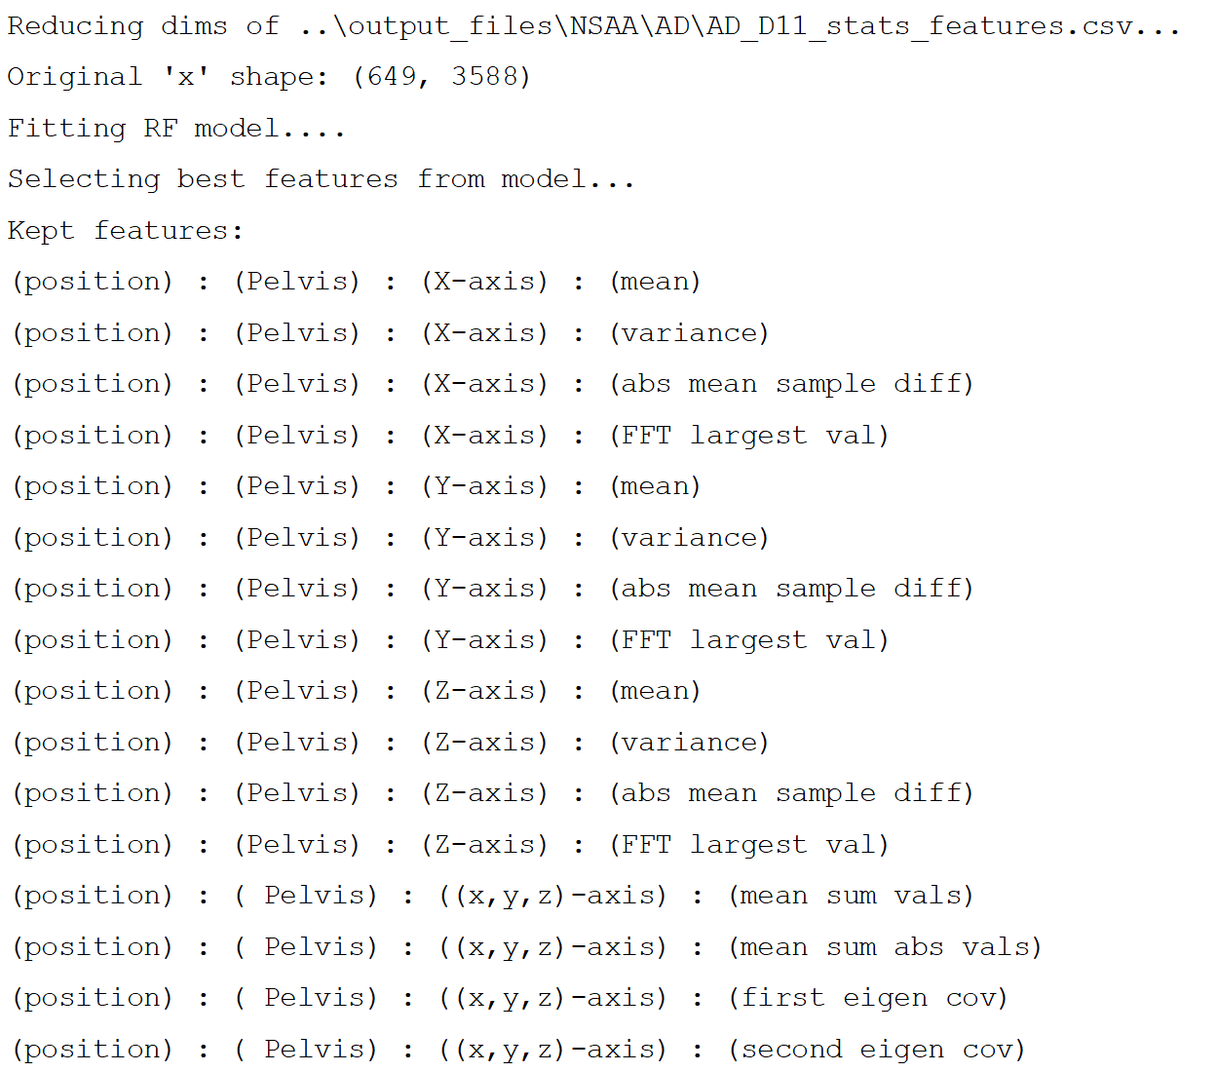
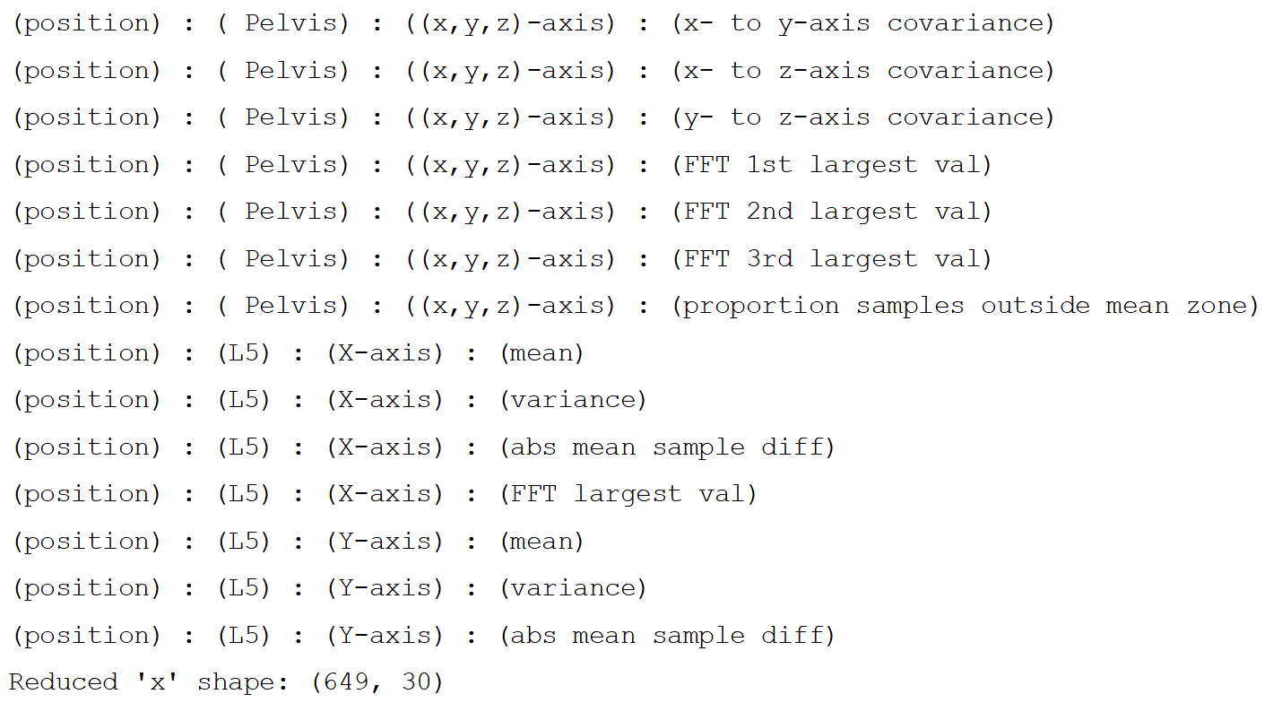
Insights from Feature Selection
Alternative to our default of dimensionality reduction via PCA is feature selection, i.e. selection of the features that account for most variance in data
Too many dimensions from extracted statistical values to feasibly train a model
For each measurement (~7 total currently), for each feature of that measurement (e.g. 17 if from raw sensor values, 22 if joint angles, 23 if segments), and for each statistical operation (~23 in total), produces a unique value as one ‘statistical value
7 * 21 * 23 = ~3381 dimensions, many of which aren’t particularly useful
Rather than feature reduction to reduce dimensions to different axes a la PCA, can simply select most useful ones by certain metrics
E.g. running the command ‘python ft_sel_red.py NSAA AD D11 rf --no_normalize --num_features=30 --dis_kept_features’, we get the output:
This output, when repeated over other source files other than ‘NSAA\D11’, will hopefully be useful in determining what features are most useful for CRF model
May also provide insight into best measurements to look at using raw data from (i.e. apart from just joint angles)

Slide 8
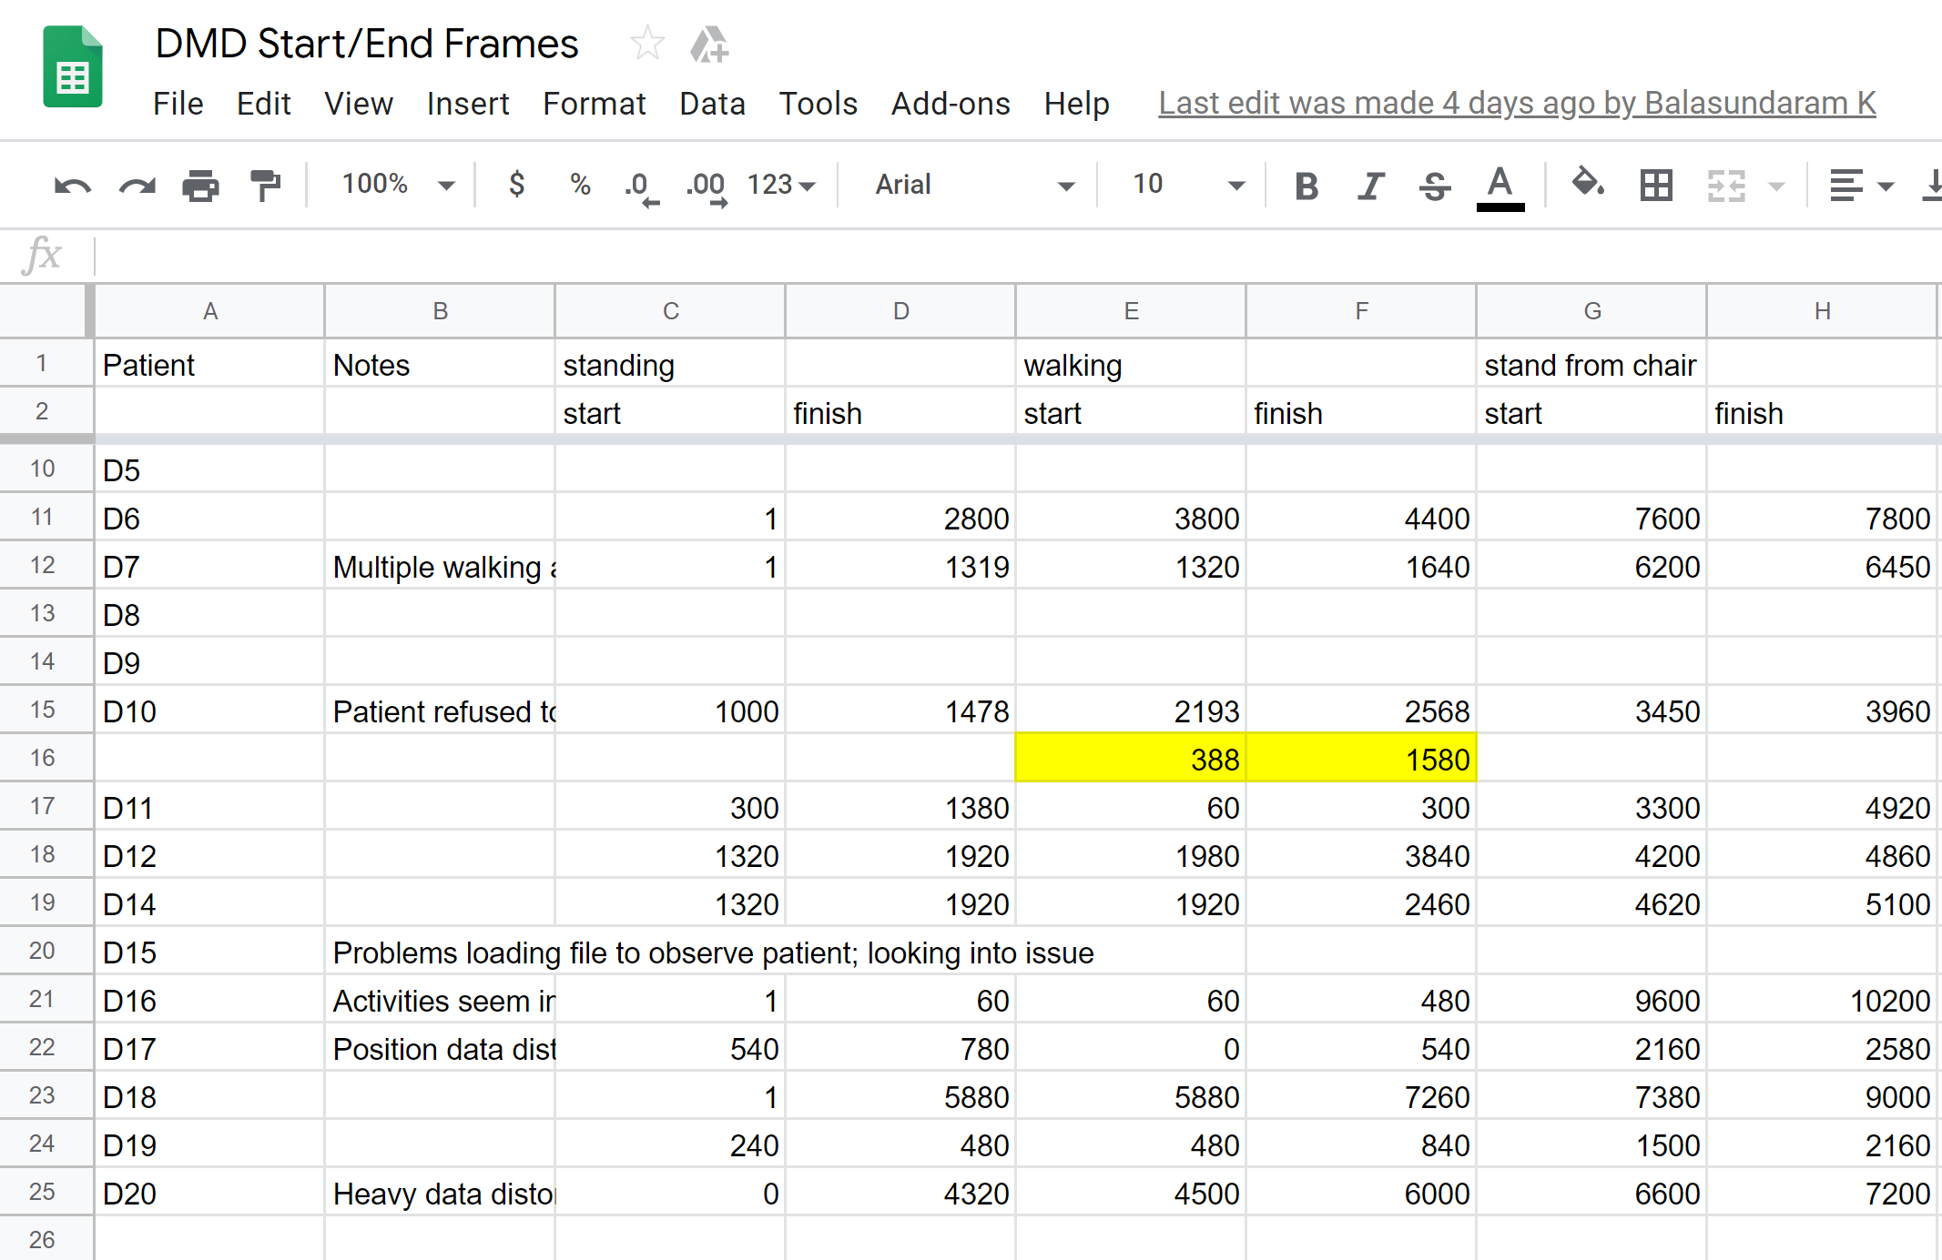
Data Preprocessing and ‘mat_act_div.py’
Names of files to divide up into single activity files
(e.g. ‘D11’)
Divided up original file based on single activity times:
‘D11-012-NSAA_act1.mat’
‘D11-012-NSAA_act2.mat’
‘D11-012-NSAA_act3.mat’
etc
Extracted list of dictionaries containined start and end times of each activity:
[[[540, 780], [0, 540] …]],
[[1, 5880], [5880, 7260]] … ]

Slide 9
Next Steps…
Preliminary results indicate that raw data works better than extracted features to be applied to RNN
Possible next approach could be to extract raw data from other measurements (e.g. position values, accelerometer values, etc.) from ‘all data’ files) and feed into RNN the same way as we did for joint angles and compare results
Use the divided-up source .mat files with a modified RNN to work with single-act .mat files to predict the single-act score for the activity in question and predicted overall NSAA score for person in question
I.e. if a sequence comes from ‘D11-012-NSAA_act1.mat’, what is the predicted NSAA score of ‘activity 1’ (standing) for the sequence?
Modify batch file (or add additional batch files) to automatically run the necessary data pipelines rather than running the individual scripts in turn
Create preliminary CRF model using the a feature selection option of ‘ft_sel_red.py’ on ‘all-data’ statistical values to build a predictive model similar to RNN
Ideally, find a way to integrate the two methods as done in several other studies
Add to ‘mat_act_div’ script a function to detect activities within a source ‘all-data’ file by changing position values over time (or by another measurement, e.g. accelerometer values)
Would be able to help automate the data annotation process that we manually did the previous week if we need to do so again in future

